Slide 1
IEEE 802.11:Wi-Fi

Slide 2
Outlines the architecture and defines the MAC and physical layer specifications for wireless LANs.
Wi-Fi uses high-frequency radio waves instead of cables for connecting the devices in LAN.
Benefits of Wi-Fi:
Mobility: Devices can move around within the network coverage area without losing connection.
Convenience: Wi-Fi eliminates the need for cables, making it easier to set up and use a network.
Scalability: WLANs can be easily expanded by adding more access points.
Interconnectivity: Wi-Fi networks can seamlessly integrate with wired networks and cellular data connections.

Slide 3
Components of Wi-Fi Architecture
Station: Stations (STA) comprise all devices and equipment that are connected to the wireless LAN. It can be of two types:
Wireless Access Point (WAP): WAPs or simply access points (AP) are wireless routers that bridge connections for base stations.
Client: Examples include computers, laptops, printers, and smartphones.
Access Point: Functions as a connection between the wireless medium and distributed systems.
Distribution System: A system used to interconnect a set of Basic Service Sets (BSSs) and integrated LANs to create an Extended Service Set (ESS).

Slide 4
Frame: It is a MAC protocol data unit.
SSID (Service Set Identifier): The network name for a specific WLAN. All devices on the same WLAN must use the same SSID to communicate.
SDU (Service Data Unit): An input data unit for each layer, which can be fragmented or aggregated to form a PDU.
PDU (Protocol Data Unit): An output data unit specific to each layer.
Network Interface Controller (NIC): Also known as a network interface card, it connects devices to the network.
Portal: Serves as a gateway to other networks.

Slide 5
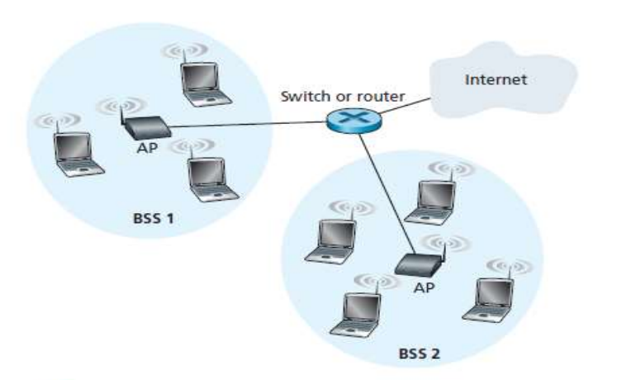
Wi-Fi Architecture
The fundamental building block of the 802.11 architecture is the Basic Service Set (BSS).
A BSS contains one or more wireless stations and a central base station, known as an access point (AP). Stations from different BSSs interact through the AP, which functions as a bridge, linking multiple WLAN cells or channels.
Each 802.11 wireless station has a 6-byte MAC address that is stored in the firmware of the station’s adapter (that is, 802.11 network interface card).

Slide 6
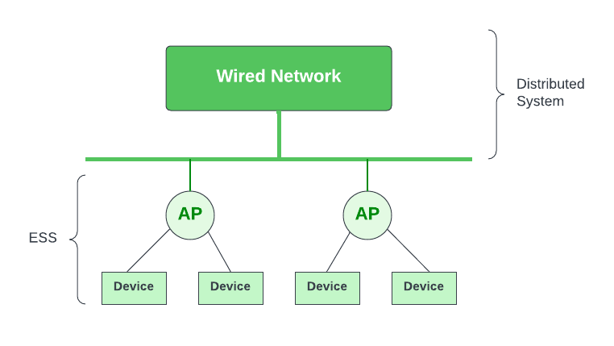
Depending upon the mode of operation, BSS can be categorized into the following types:
Infrastructure BSS: Communication between stations takes place through access points. The AP and its associated wireless clients define the coverage area and form the BSS.

Slide 7
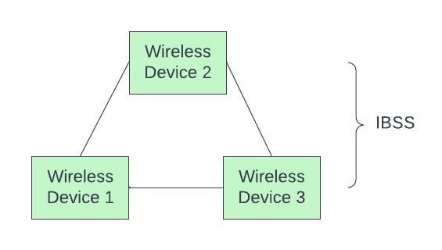
Independent BSS – Supports mutual communication between wireless clients. An ad-hoc network (A BSS without an AP) is spontaneously created and does not support access to wired networks.
In an environment with multiple access points (like a large office building or campus), a device can move from the range of one AP to another and still maintain its connection. This is possible due to the underlying architecture of the IEEE 802.11 standard which allows for roaming between APs..

Slide 8
Once a wireless station is associated with an AP, it can start sending and receiving data frames to and from the access point.
But because multiple stations may want to transmit data frames at the same time over the same channel, a multiple access protocol is needed to coordinate the transmissions.
CSMA
CSMA/CA
To ensure reliable data delivery over potentially error-prone wireless channels, Wi-Fi uses link-layer acknowledgments: the receiver sends an ACK frame upon successful reception, triggering retransmission if not received within a timeout.

Slide 9
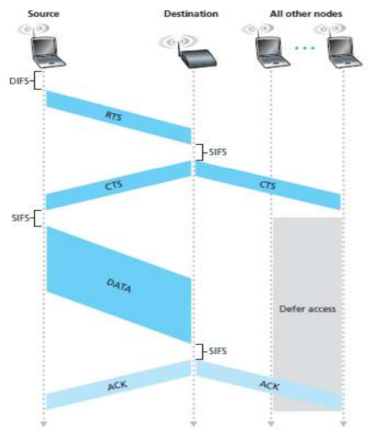
When a sender wants to send a DATA frame, it can first send an Request to Send (RTS) frame to the AP, indicating the total time required to transmit the DATA frame and the acknowledgment (ACK) frame.
When the AP receives the RTS frame, it responds by broadcasting a Clear to Send (CTS) frame. This CTS frame serves two purposes: It gives the sender explicit permission to send and also instructs the other stations not to send for the reserved duration.

Slide 10
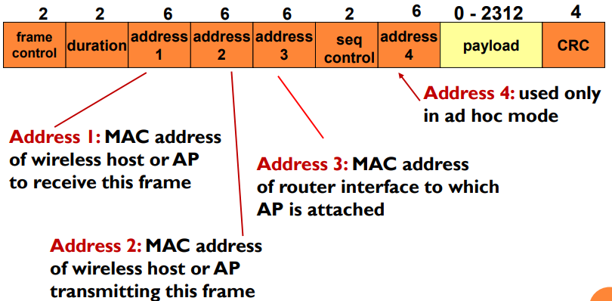
Wi-Fi Frame

Slide 11
Wi-Fi Frame
Frame Control: It is 2 bytes long and defines type of frame and control information.
Duration: It contains the value indicating the period of time in which the medium is occupied
Sequence Control: It consists of 2 sub-fields i.e. sequence number (12 bits) and fragment number (4 bits). Sequence number is used to filter duplicate frames.
Data: It is a variable length field which contains information specific to individual frames which is transferred transparently from a sender to the receiver.
CRC: It contains 32 bit CRC error detection sequence to ensure error free frame.

